Slide 1
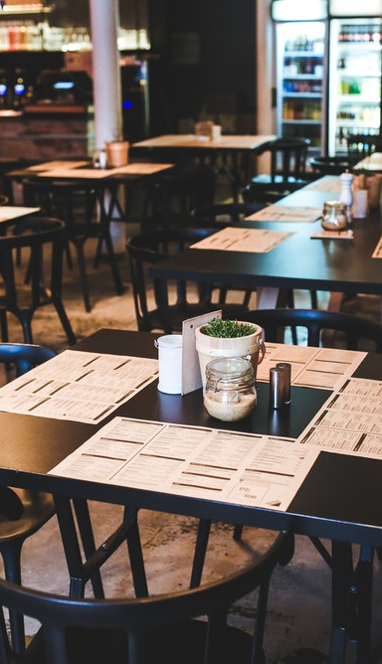

Tiller by SumUp Final project
Brenda Nuñez | Claudia Brenes | Nancy Muñoz | Yan Zheng

Slide 2
Tiller by Sum Up
Tiller by Sumup is more than a cash register; it’s an ecosystem of solutions that enables restaurant owners to manage their business.
Currently, they do not provide any analytical tool to restaurant owners, but they are now focusing on it

Slide 3
What are we trying to do? For whom and why?
The goal
For Whom
Implement a tool for the analysis of data collected from Tiller
For tiller users

Slide 4

Data Analysis

Slide 5
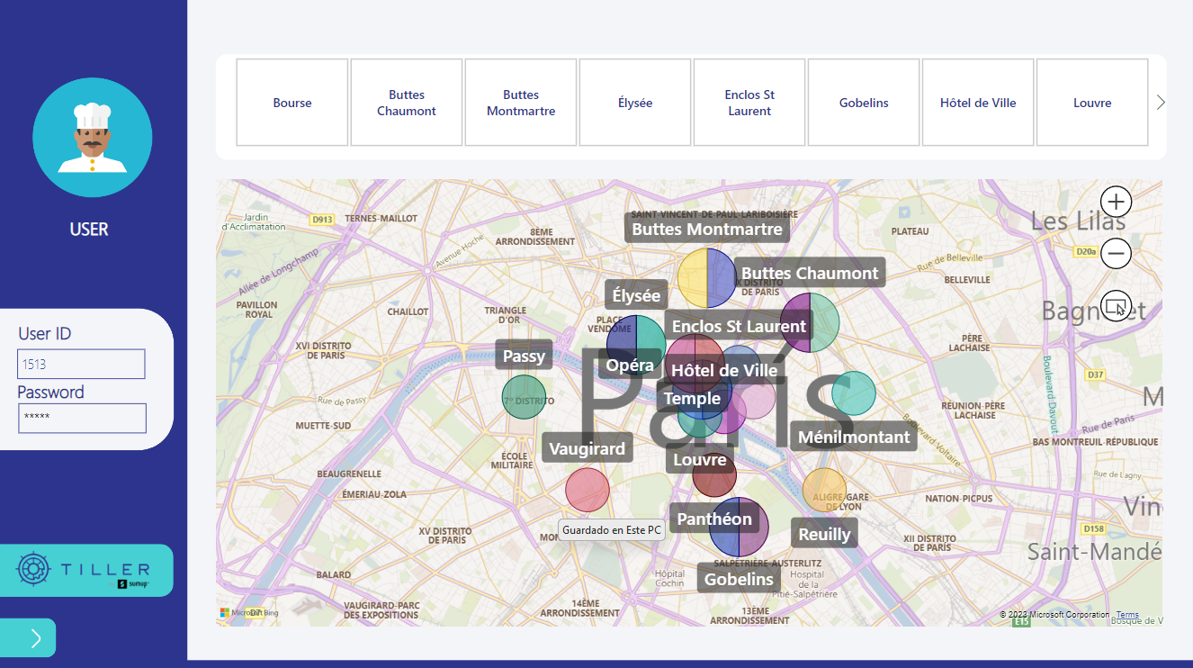

Slide 6
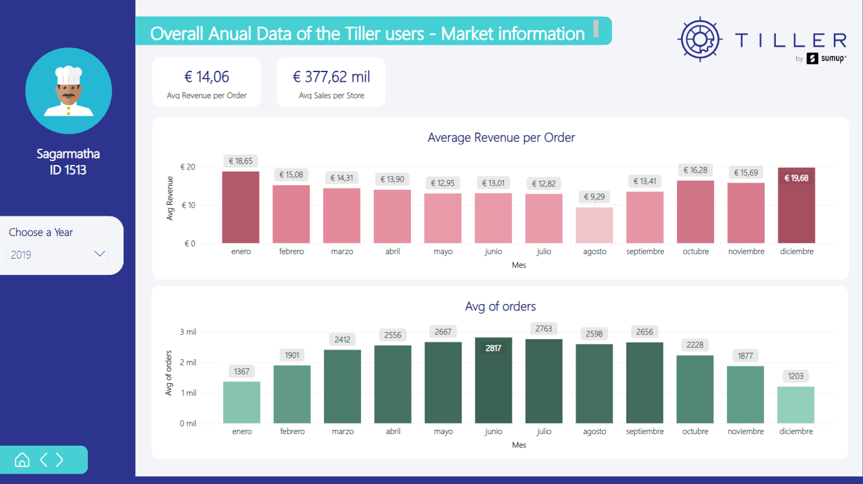

Slide 7
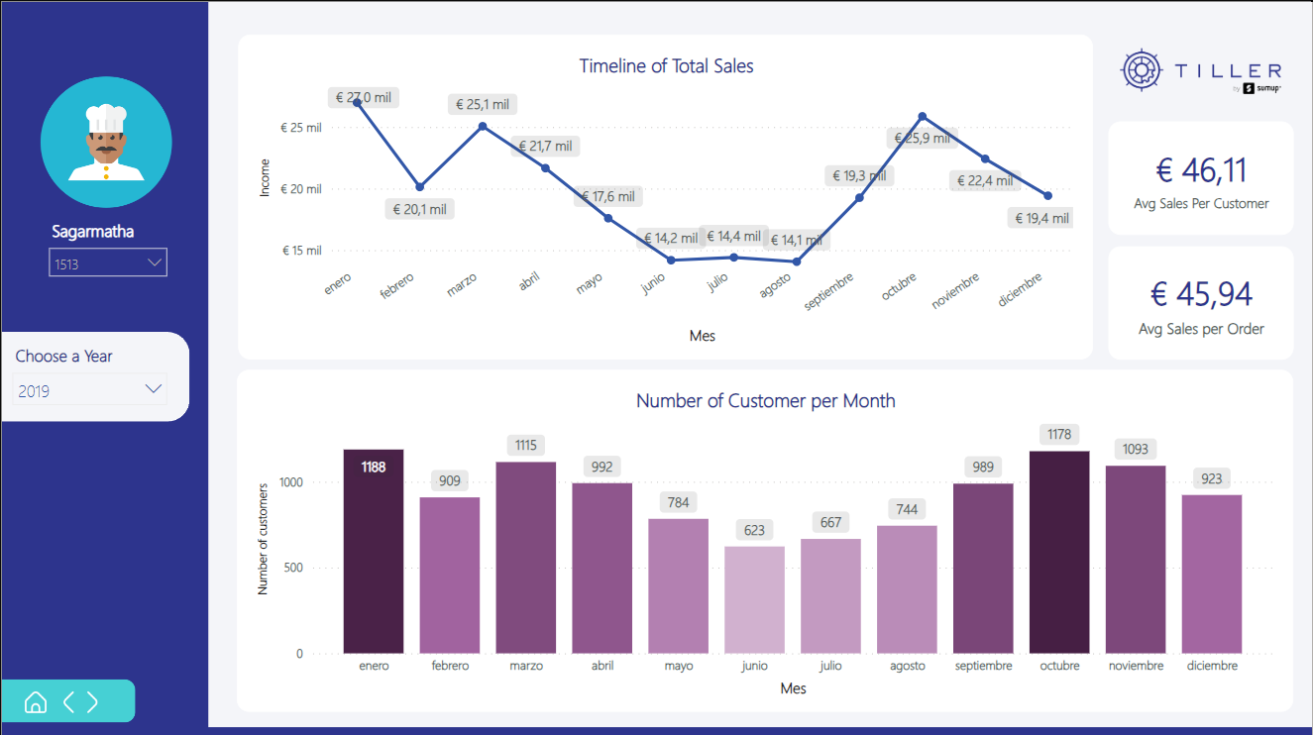

Slide 8
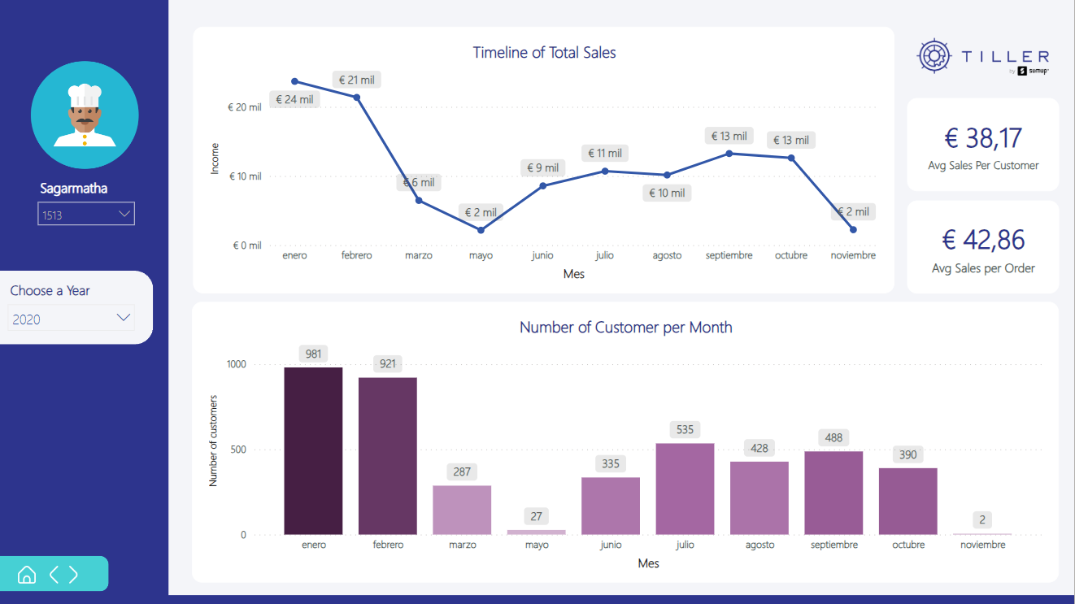

Slide 9
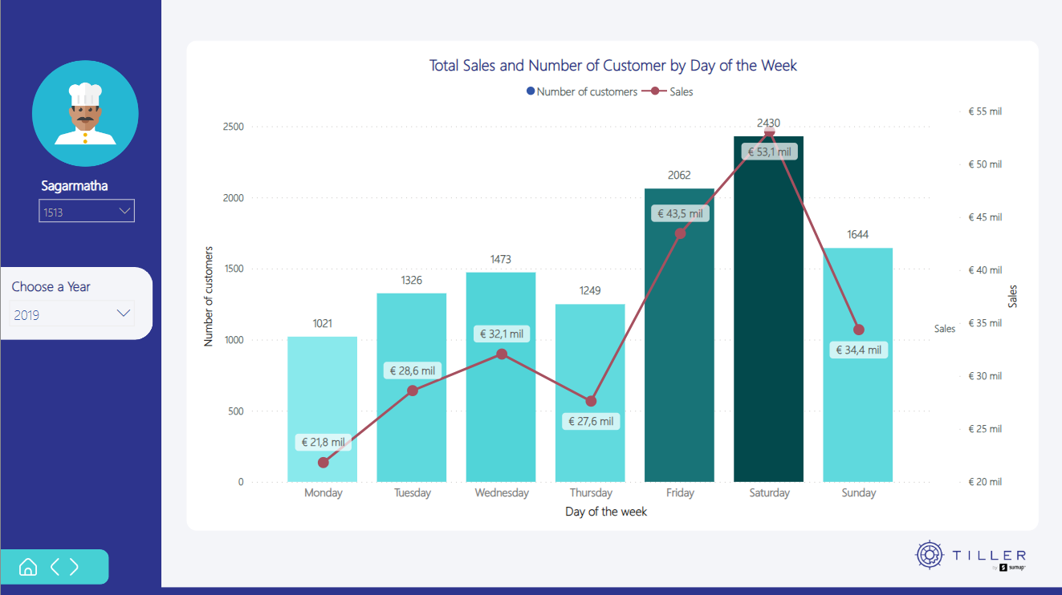

Slide 10
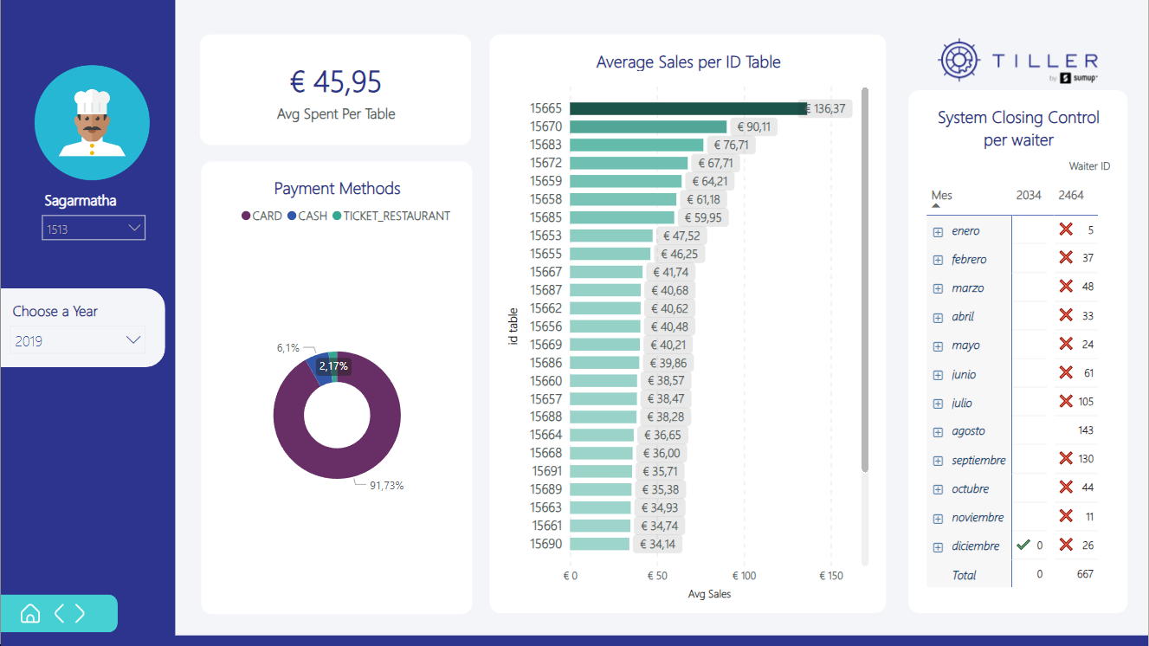

Slide 11


Slide 12
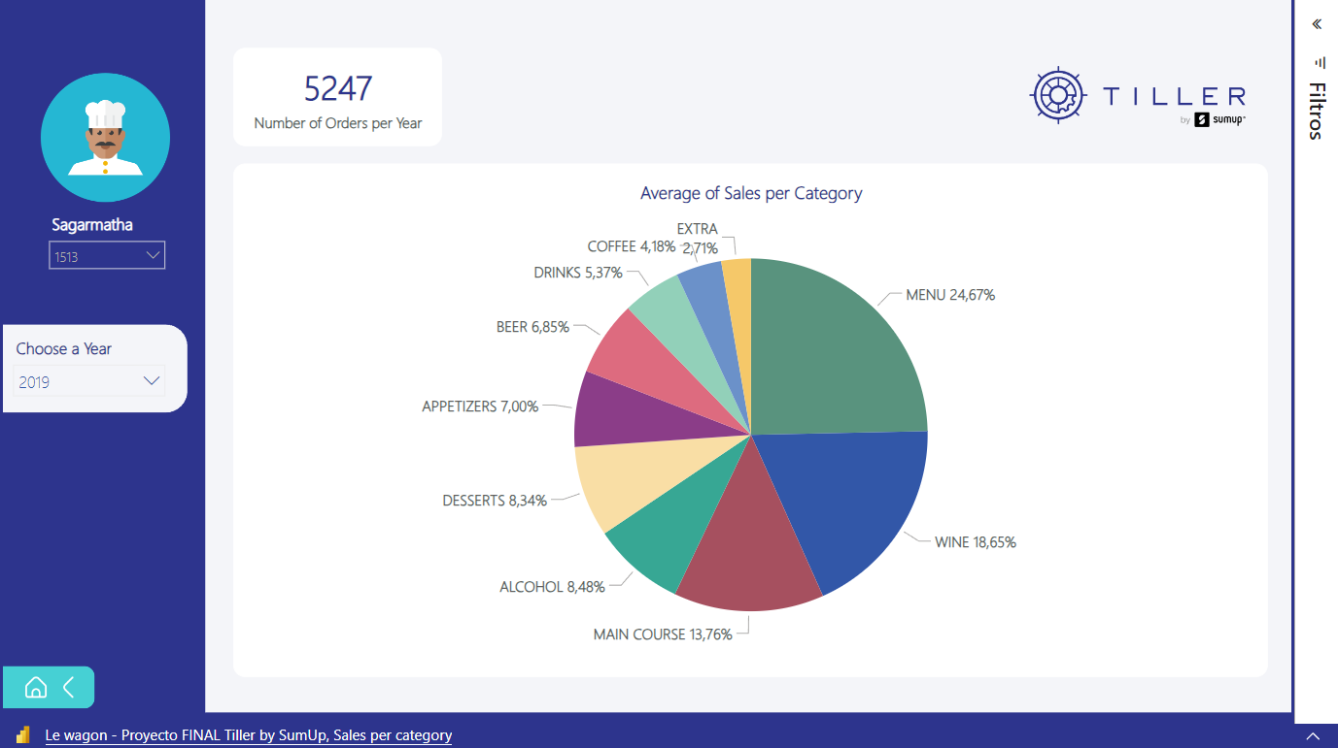

Slide 13

Recommendations

Slide 14

Recommendations
Tiller should implement a training program for application users, specifically restaurant owners. The primary goal of this training would be to instruct them on the importance of providing accurate and complete data as required by the system.
Tiller should place particular emphasis on product categorization, enabling restaurants to gain a better understanding of the data.

